Slide 1
Introduction to Computer Science: Programming Methodology
Tutorial 1
Introduction and Number System
朱翔宇
220019187@link.cuhk.edu.cn
Tutorial: 6-9pm Wed TD209
Office hour: 8-9am Wed Zhixin203B

Slide 2
Outline
Introduction
Teaching Fellows and Schedule
Install Python
About Assignments and Exams
Some Tips
Number System
Positional Notation
Conversion
One-to-one Relationship

Slide 3
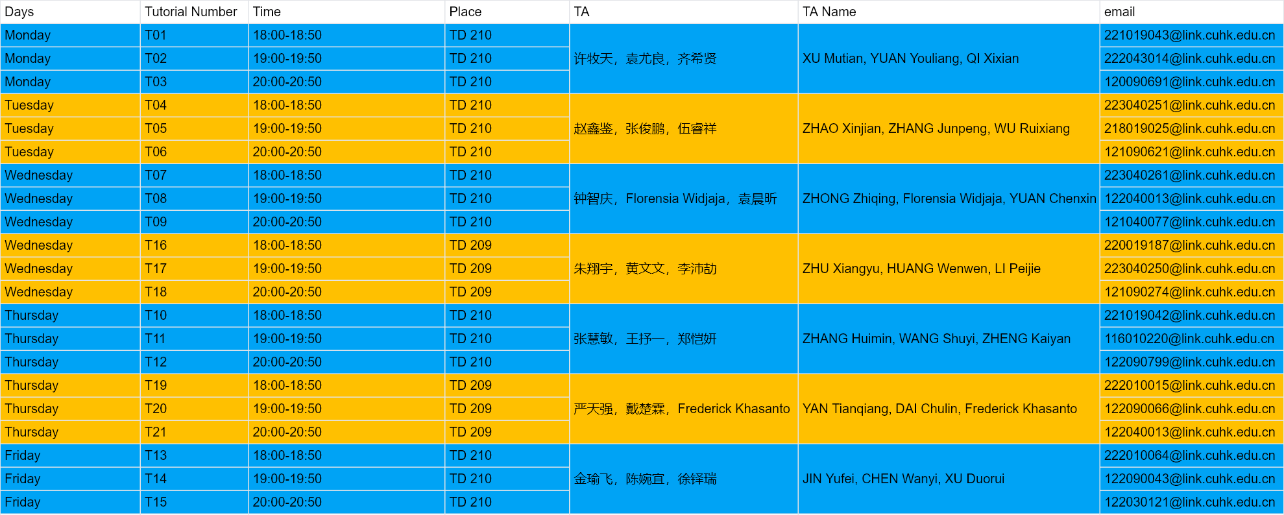
Teaching Fellows
TAs for Tutorial:

Slide 4
Tutorial Schedule
Week | Tutorial | Topics
2 | Tutorial 1 | Introduction and Number System
3 | Tutorial 2 | Python Basics
4 | Tutorial 3 | Flow Control
5 | Tutorial 4 | Functions
6 | Tutorial 5 | Functions and String
7 | Tutorial 6 | List
8 | Tutorial 7 | Object Oriented Programming
9 | Tutorial 8 | Object Oriented Programming II
10 | Tutorial 9 | Algorithm Analysis
11 | Tutorial 10 | Recursive Algorithm
12 | Tutorial 11 | Stack and Queue
13 | Tutorial 12 | Linked List
14 | Tutorial 13 | Tree

Slide 5
What We Do in Tutorials
Writing python codes to solve problems. Around 3~6 problems in one tutorial.
TAs may explain the algorithms and python codes, or discuss and answer some questions from students about the lectures.

Slide 6

Survey
How many of you guys are familiar with ?
Notes:
So just hands up if some one is familiar with Python
Fine, I got the idea

Slide 7
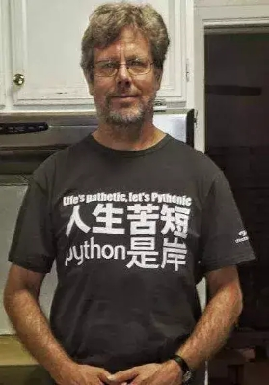
Why Python?
Some reasons:
Easy to Read, Learn and Write
Simple and Productive
Vast Libraries Support
Guido van Rossum
Father of Python
Notes:
It is relatively easy for programming beginners
1. Its grammar is closed to natural language,
2. productive means with Python, you can write less codes and get more things done, compared with c++/c
3. Numpy, Scipy(Scientific Computation), PyTorch, Tensorflow(Deep Learning)..., you can find mass of learning resources online, and get answers easily, on website like Stackoverflow
What's more important, Python is useful indeed

Slide 8

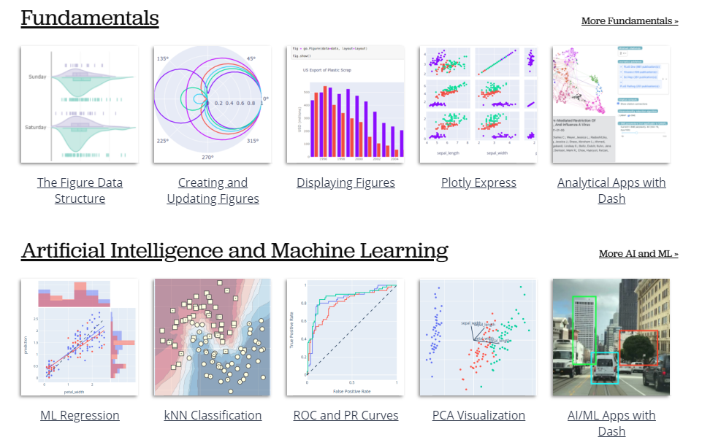
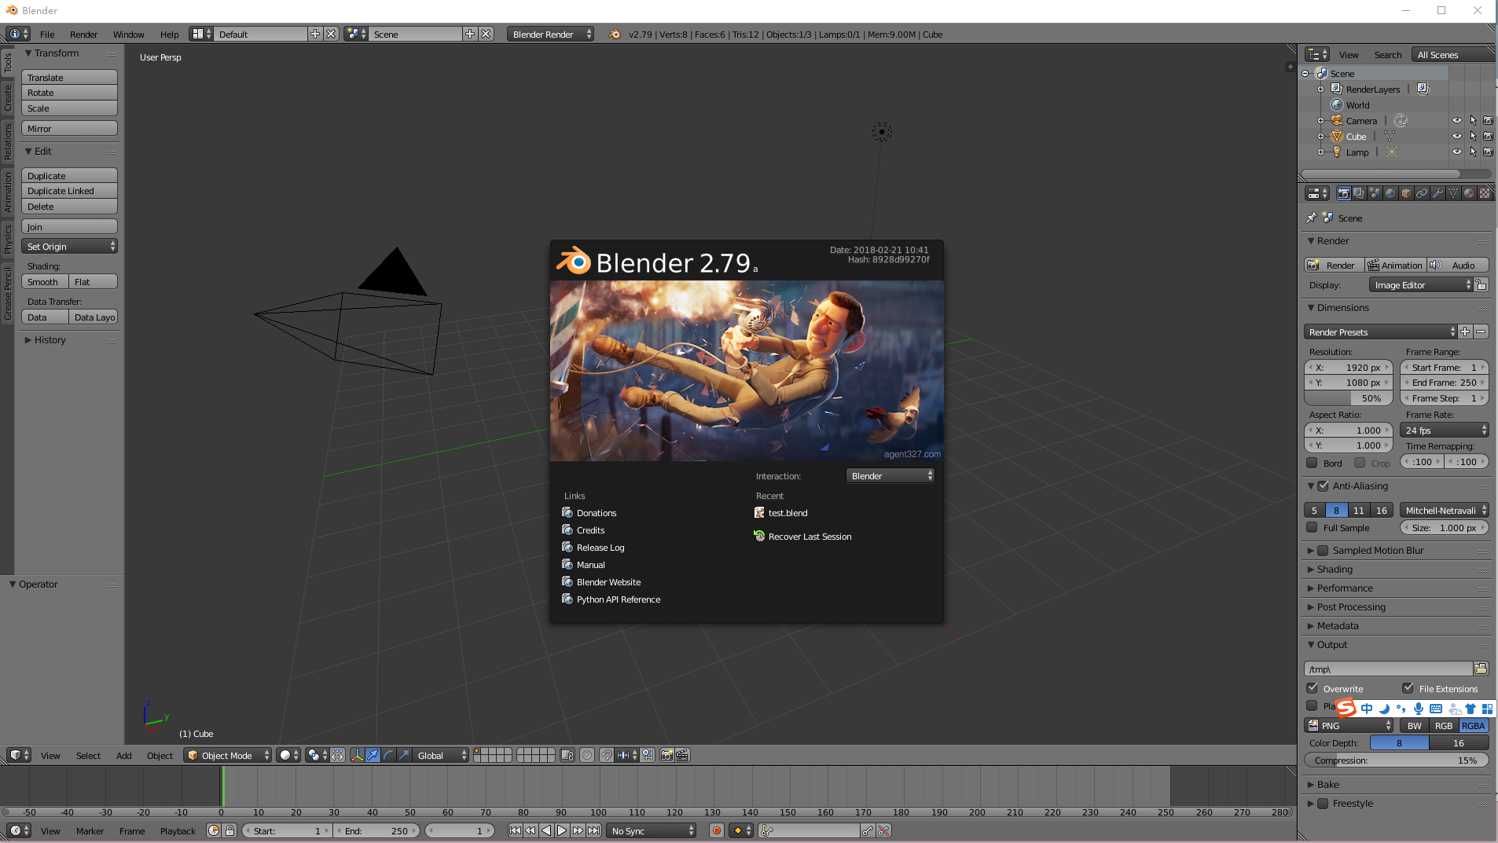
Python World
Relevant to Python
Data Visualization
3D Modeling/Render/Games
Notes:
For web development, both frontend and backend, you can use Python
to visualize data, plotly
blender 3d modeling, rendering, make movies, and make simple games.
most of them are open source and free

Slide 9




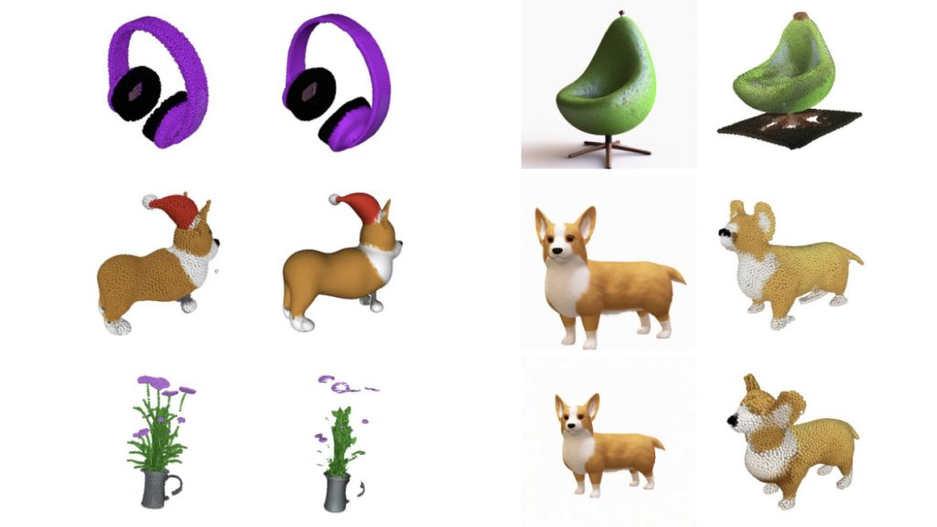
Python World
Deep Learning
Large Language Model
近看成狗，远看成坤
Generate 3D Models
Notes:
And you may heard of Deep Learning,
Include Image processing, natural Language processing, reinforcement Learning like alphago
And yes, Now Python is the most popular programming language in this area

Slide 10
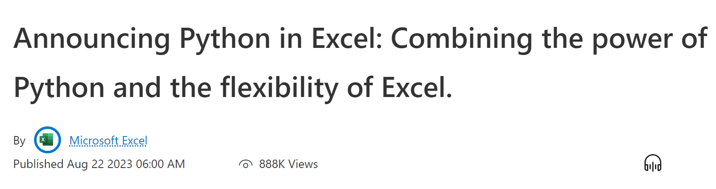
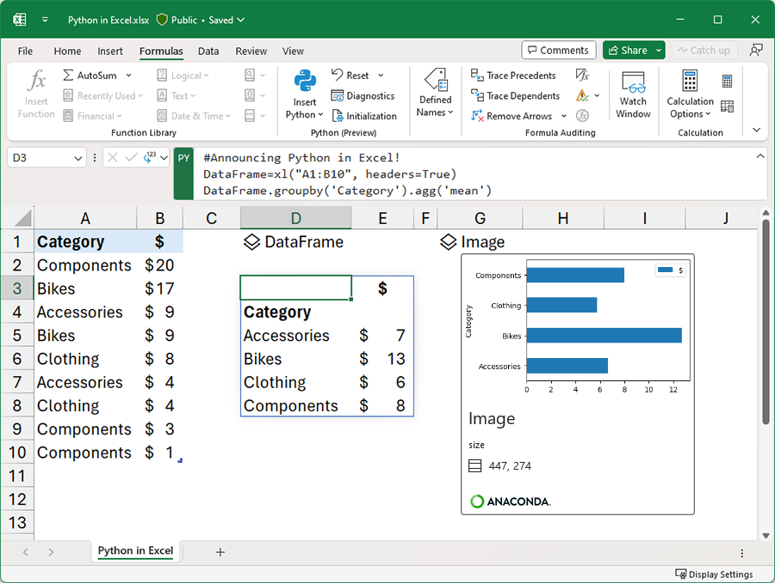
Python World
Even in Microsoft Excel!
Notes:
And you may heard of Deep Learning,
Include Image processing, natural Language processing, reinforcement Learning like alphago
And yes, Now Python is the most popular programming language in this area

Slide 11
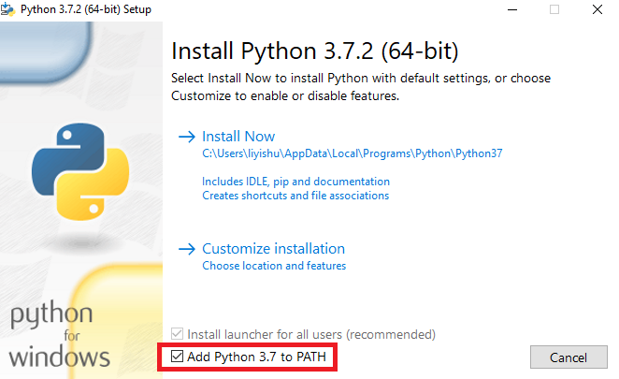
Installation
Download stable version (>=3.6) from
https://www.python.org/
Do remember to download the correct version for your own platform (Windows/Linux/MacOS)
Install step by step.
Make sure you’ve Added Python PATH to Environment Variables.
Old, Stupid, Hard to use
Notes:
Now you have know the importance of learning Python, Now Let me show you how to install it

Slide 12

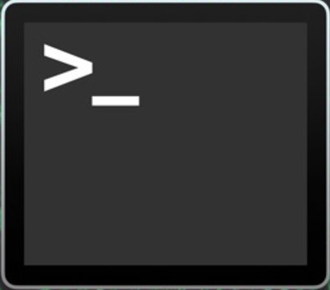


Installation: Better Choices
Better Choices for running Python:
PyCharm and Anaconda(Spyder) are IDE for Python
Terminal
PyCharm
IDE : Integrated Development Environment
Anaconda3
Notes:
But there are more better choices
for Mac/linux users you can install python directly in Terminal, just use command line
And if you are looking for a python IDE, PyCharm may be a good choice, especially when you want to use Python to do a big project.
And for me personally, I strongly recommend Anaconda3, besides Python itself, it integrates many useful softwares, like Spyder(a Python IDE), and Jupyter Notebooks(Like Google Colab).
It can help you in your research.
Just search online to see how to install them.

Slide 13



Installation: Better Choices
Better Choices for writing Python code:
Sublime
Text
They are Text Editors
(Not only for codes)
Atom
VSCode
On Remote Server:
Vim; Emacs; VSCode Remote
Notes:
But there are more better choices
for Mac/linux users you can install python directly in Terminal, just use command line
And if you are looking for a python IDE, PyCharm may be a good choice, especially when you want to use Python to do a big project.
And for me personally, I strongly recommend Anaconda3, besides Python itself, it integrates many useful softwares, like Spyder(a Python IDE), and Jupyter Notebooks(Like Google Colab).
It can help you in your research.
Just search online to see how to install them.

Slide 14
Installation: Better Choices
Coding workflow:
Sublime
Text
Terminal
PyCharm
Atom
VSCode
Anaconda3
Notes:
But there are more better choices
for Mac/linux users you can install python directly in Terminal, just use command line
And if you are looking for a python IDE, PyCharm may be a good choice, especially when you want to use Python to do a big project.
And for me personally, I strongly recommend Anaconda3, besides Python itself, it integrates many useful softwares, like Spyder(a Python IDE), and Jupyter Notebooks(Like Google Colab).
It can help you in your research.
Just search online to see how to install them.

Slide 15
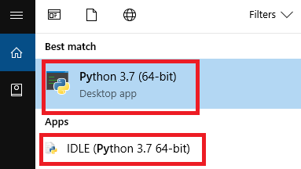
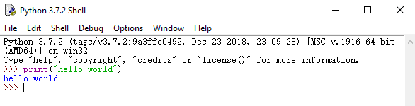
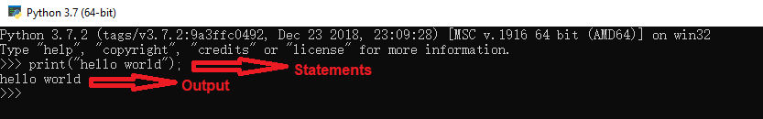
Hello World!
Search “python” in start menu (Windows)
Open Python desktop app or IDLE.
You can write your code statement under shell (e.g. type “print(“hello world”);”
Press enter and then the code will be executed. (“hello world” will be printed)
Notes:
After the installation,

Slide 16
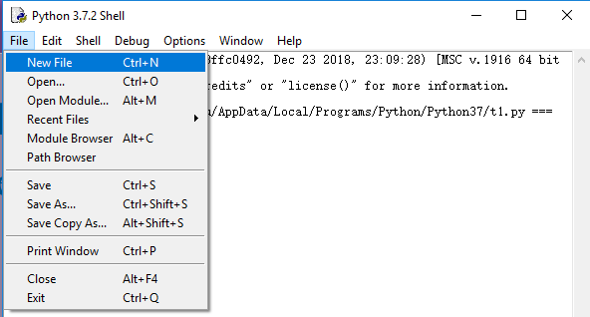
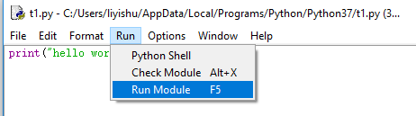
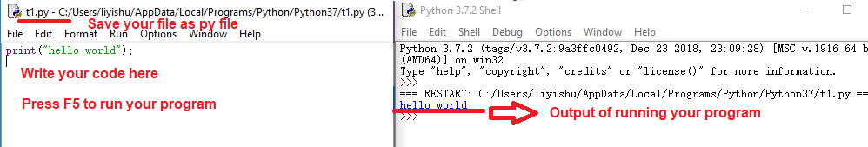
hello_world.py
In IDLE, you can also open or new a py file. Write your code in this file, and then press “F5” (or “Run” -> “Run Module”) to run your program.

Slide 17
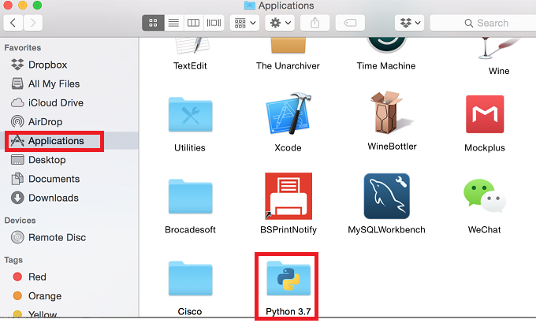
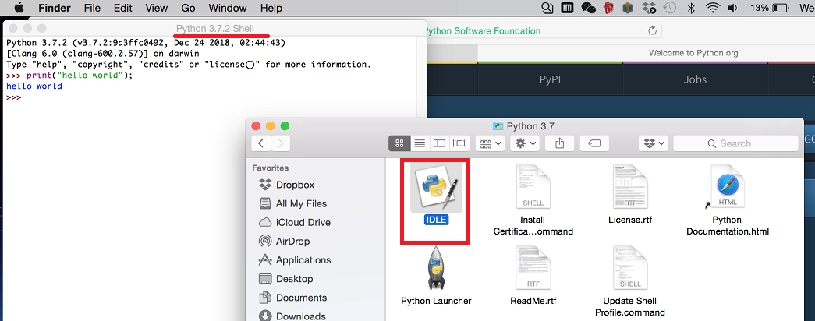
hello_world.py
For MacOS, you will find a folder named “Python 3.7” being displayed under Application.
Double click “IDLE” and you will see the Shell and can write your py file or write your code in shell directly.

Slide 18




hello_world Online
Write and Run Python Online:
Recommend: Google Colab(Need Google Account)
Learn more about these tools(IDE,TextEditor,Colab...)
e.g. To search
-Colab tutorial for beginners
-VSCode入门教程
-How to use Anaconda in Mac
-...

Slide 19
Assignments and Exams
Assignments are about writing codes to solve problems, codes (.py) and explanations(.pdf)(examples will be uploaded to BB) about your programs(zipped into one file) are supposed to be uploaded to the BB before the deadline.
Passing deadline will deduct some points, 3 days after deadline won’t be accepted.
Exams are paper forms, about understanding the lecture notes and writing simple codes on exam papers.

Slide 20
Some Tips
Learn based on lecture notes. Practice, practice and practice.
Programs are to help you solve problems, but it is still you to solve the problems, computer is just to calculate faster. So you should solve the problems by yourself first for the simpler cases, then design algorithms to let computer do it.
Before midterm: basic tools(data types, if else, for, while) to solve problems, similar to a designed calculator.
After midterm: abstract concepts(functions, class, algorithm, list, tree etc.), to combine tools into a “machine” with functionalities.
Notes:
And if you solve the problems, you can also find if there exists a more elegant way on Internet

Slide 21
Some Tips of Mine
Some principles of writing codes:
1). Runnable and Correct
2). Readable(可读)
3). Easy to maintain and modify
Notes:
As for writing codes, there are some principles.
First, of course it should be runnable. For you beginners, you may carefully check if there is some syntax error(in other words, grammar error)
Third, it should be easy to maintain and modify, like add some new features or function
What' more important, you should write readable codes

Slide 22
Readability
What is the Readability? Easy to read
Comment
Indentation
Names
.......
Logic
Text/File
Organization
Notes:
Readable code is code that clearly communicates its intention to the reader
when people see the codes, they can quickly get the idea what it wants to do
It is important for reader but also for you.
There are some aspects of readability

Slide 23
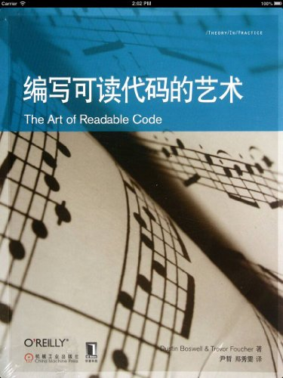
Suggestion
1. Read good codes(github, stackoverflow, your classmates...)
2.The art of Readable Code
3. Use a text editor for
good habits of coding
Notes:
there are some personal advices
In a good text editor, it can auto-complete your variables and special structures, highlighting, align your codes...
It will help you form good programming habits

Slide 24
Outline
Introduction
Teaching Fellows and Schedule
Install Python
About Assignments and Exams
Some Tips
Number System
Positional Notation
Conversion
One-to-one Relationship

Slide 25
Outline for Number System
1.Number System by positional notation representation.
binary(2), octal(8) and hexadecimal(16) and decimal(10) system.
2.Conversion between decimal system(10) and binary(2) (octal(8), hexadecimal(16)).
3.One-to-one relationship
i) octal and binary system;
ii) hexadecimal and binary system.

Slide 26
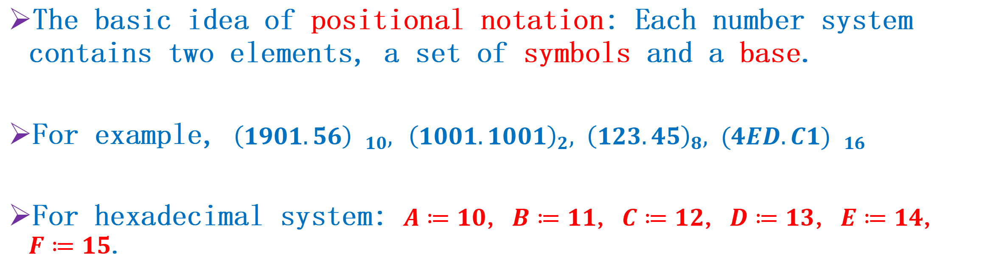
Number System
The basic idea of positional notation: Each number system contains two elements, a set of symbols and a base.
For example, ${\left(1901.56\right) }_{10},$ ${\left(1001.1001\right)}_{2},$ ${\left(123.45\right)}_{8},$ ${(4ED.C1) }_{16}$
For hexadecimal system: $A≔10$, $B≔11$, $C≔12$, $D≔13$, $E≔14$, $F≔15$.
Number system | Base | Set of symbols
Decimal system | 10 | 0,1,2,3,4,5,6,7,8,9
Binary system | 2 | 0,1
Octal system | 8 | 0,1,2,3,4,5,6,7
Hexadecimal system | 16 | 0,1,2,3,4,5,6,7,8,9,A,B,C,D,E,F

Slide 27
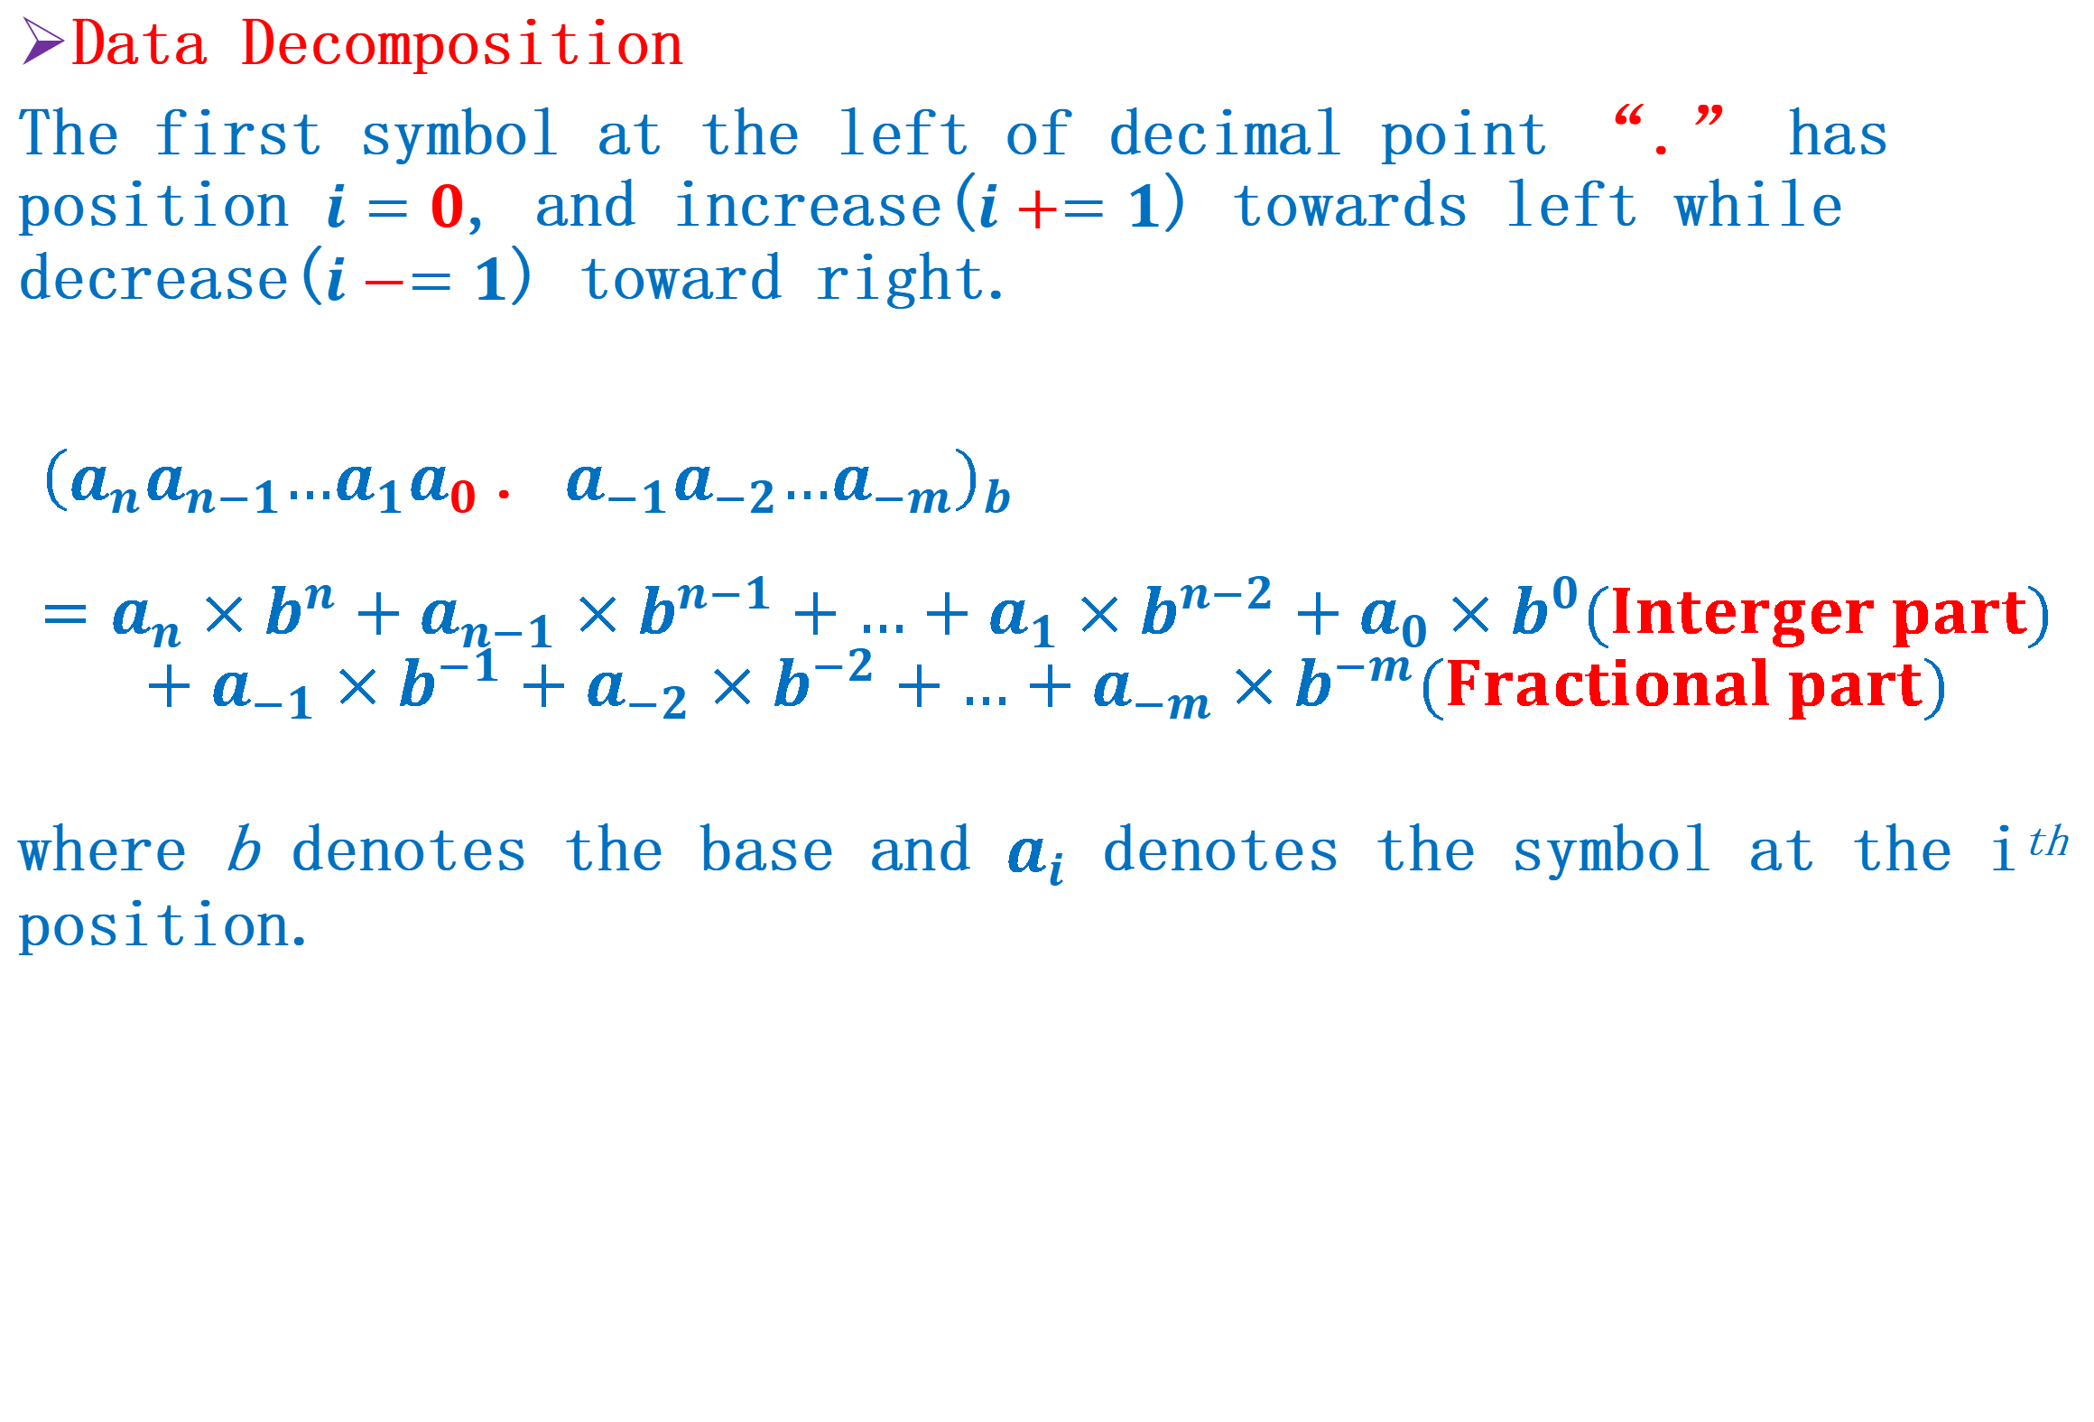
Converting into decimal number
Data Decomposition
The first symbol at the left of decimal point “.” has position $i=0$, and increase($i+=1$) towards left while decrease($i−=1$) toward right.
$${\left(a_{n}a_{n−1}{…a}_{1}a_{0} \text{.} a_{−1}a_{−2}…a_{−m}\right)}_{b}=a_{n}×b^{n}+a_{n−1}×b^{n−1}+…+a_{1}×b^{n−2}+a_{0}×b^{0}(Interger part)$$
$$+a_{−1}×b^{−1}+a_{−2}×b^{−2}+…+a_{−m}×b^{−m}(Fractional part)$$
where b denotes the base and $a_{i}$ denotes the symbol at the i^{th} position.

Slide 28
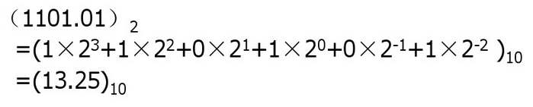
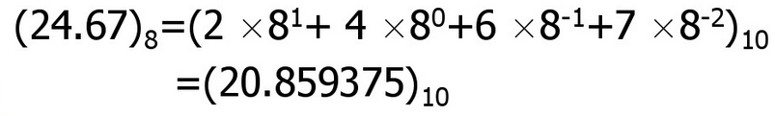
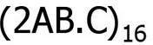
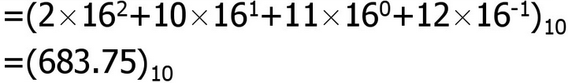
Converting into decimal number
Example1
Example2
Example3

Slide 29
Practice 1
1. Binary number 100.1 equals to decimal number _________
2. Octal number 100.1 equals to decimal number _________
3. Convert hexadecimal number 3D5.F9 into decimal number.

Slide 30
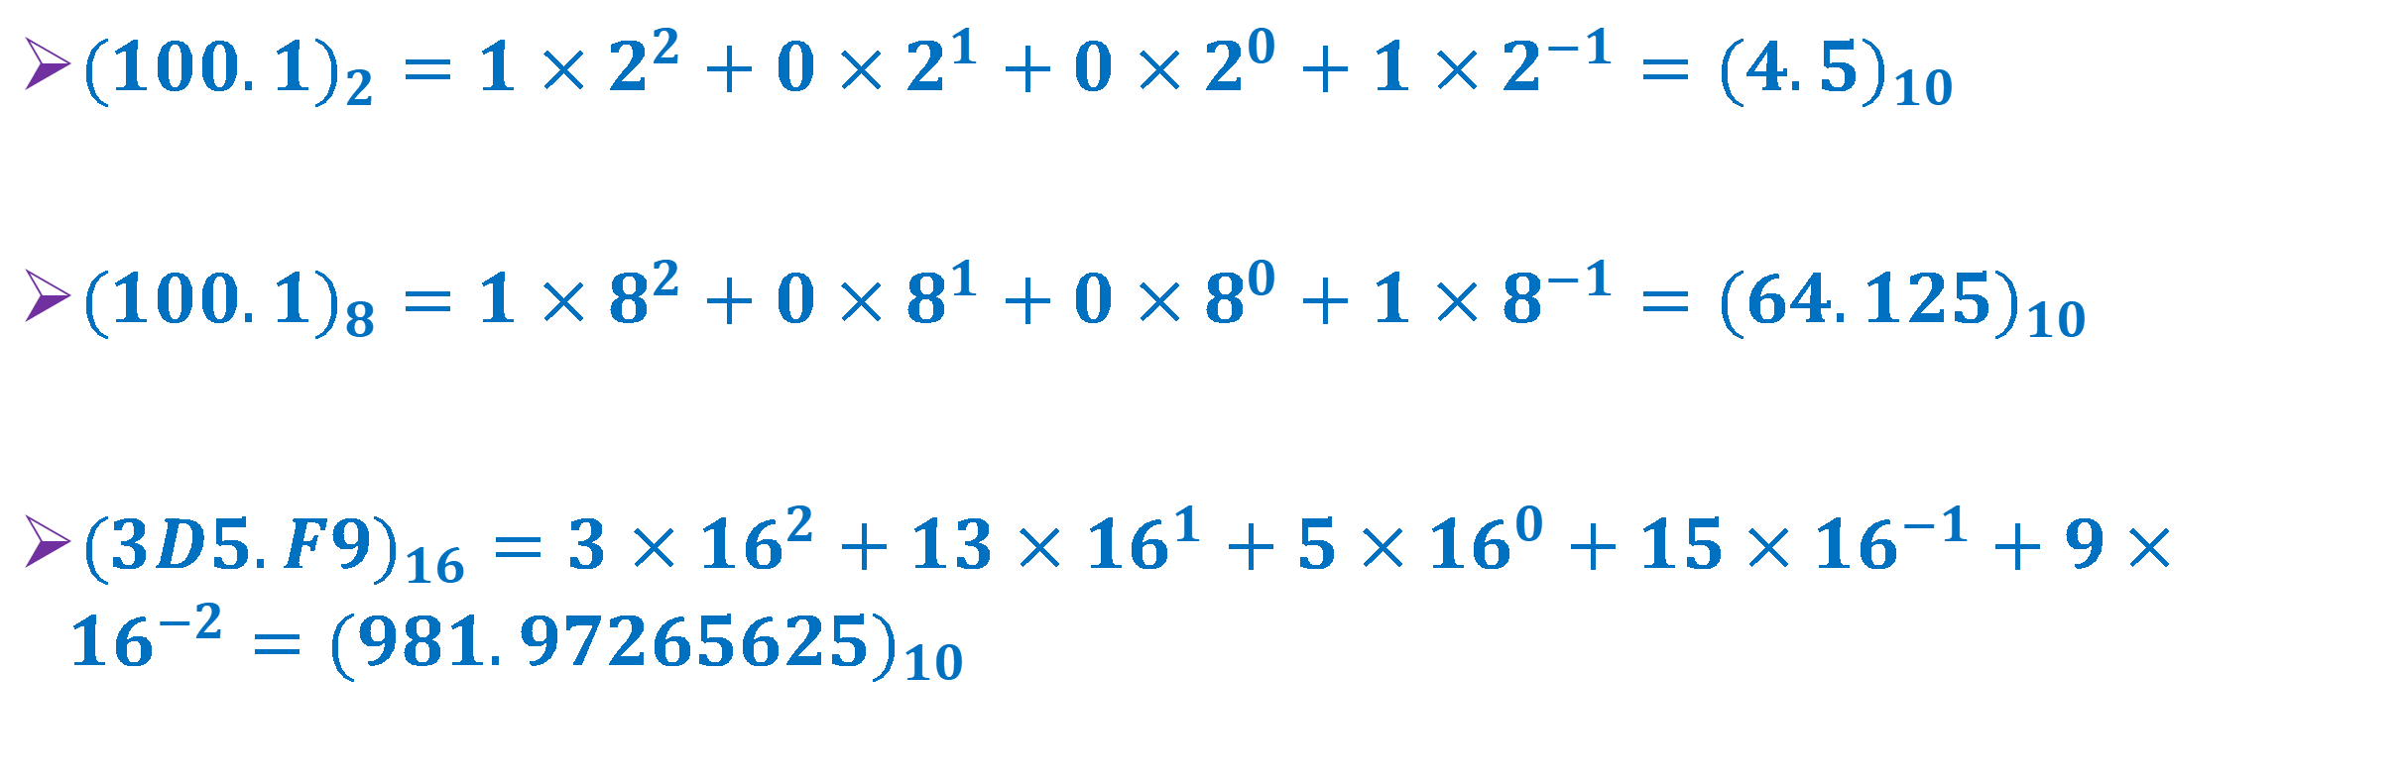
Solution
${(100.1)}_{2}=1×2^{2}+0×2^{1}+0×2^{0}+1×2^{−1}={(4.5)}_{10}$
${(100.1)}_{8}=1×8^{2}+0×8^{1}+0×8^{0}+1×8^{−1}={(64.125)}_{10}$
${(3D5.F9)}_{16}=3×{16}^{2}+13×{16}^{1}+5×{16}^{0}+15×{16}^{−1}+9×{16}^{−2}={(981.97265625)}_{10}$

Slide 31
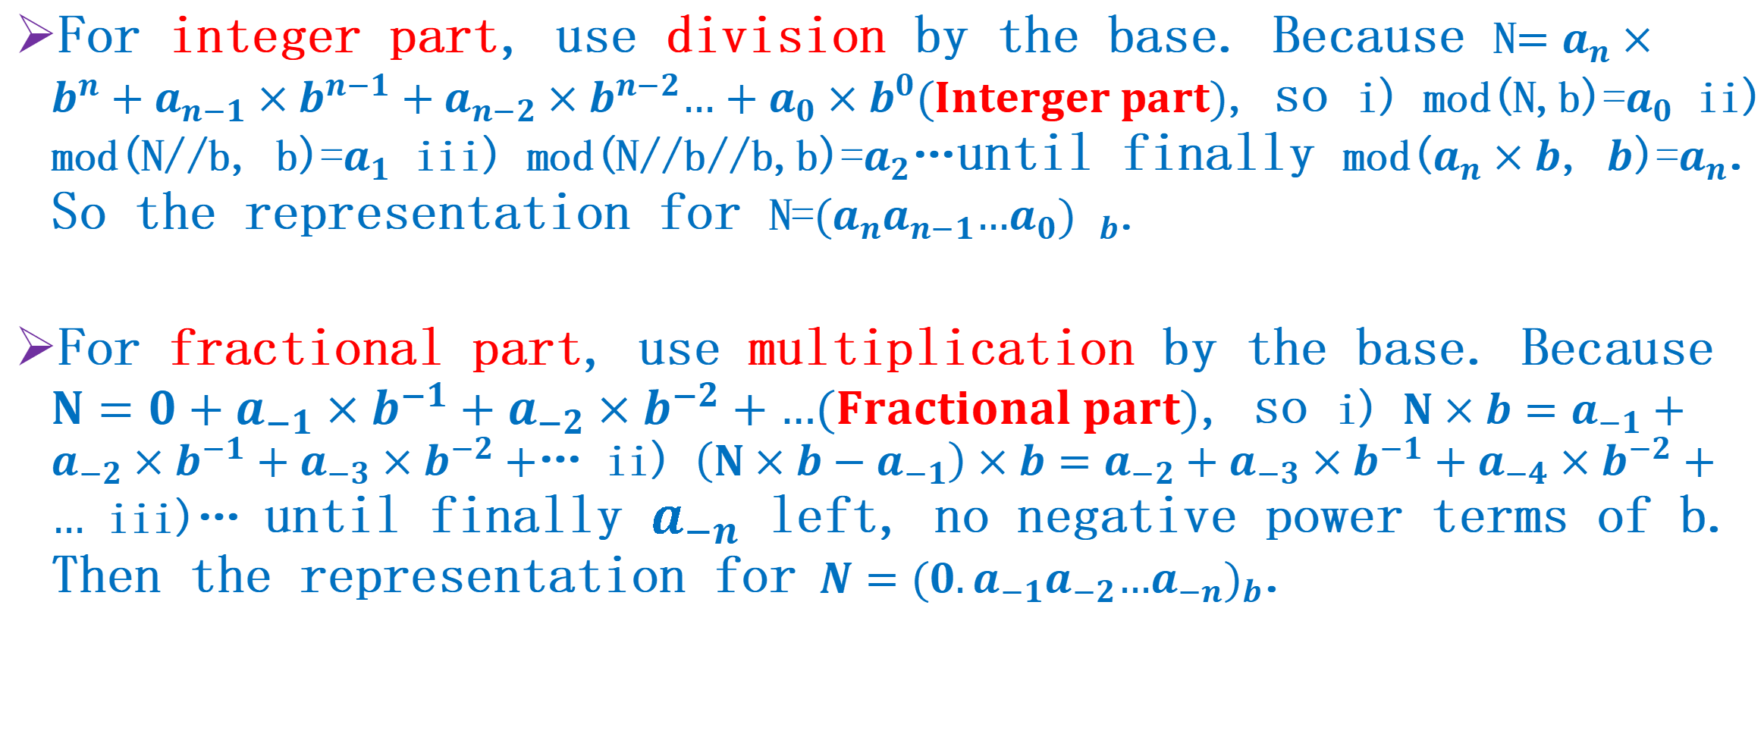
From Decimal to Others
For integer part, use division by the base. Because N$=a_{n}×b^{n}+a_{n−1}×b^{n−1}+a_{n−2}×b^{n−2}…+a_{0}×b^{0}(Interger part)$, so i) mod(N,b)=$a_{0}$ ii) mod(N//b, b)=$a_{1}$ iii) mod(N//b//b,b)=$a_{2}$…until finally mod($a_{n}×b$, $b$)=$a_{n}$. So the representation for N=${(a_{n}a_{n−1}…a_{0}) }_{b}$.
For fractional part, use multiplication by the base. Because $N=0+a_{−1}×b^{−1}+a_{−2}×b^{−2}+…(Fractional part)$, so i) $N×b=a_{−1}+a_{−2}×b^{−1}+a_{−3}×b^{−2}+$… ii) $\left(N×b−a_{−1}\right)×b=a_{−2}+a_{−3}×b^{−1}+a_{−4}×b^{−2}+…$ iii)… until finally $a_{−n}$ left, no negative power terms of b. Then the representation for $N={(0.a_{−1}a_{−2}…a_{−n})}_{b}$.

Slide 32
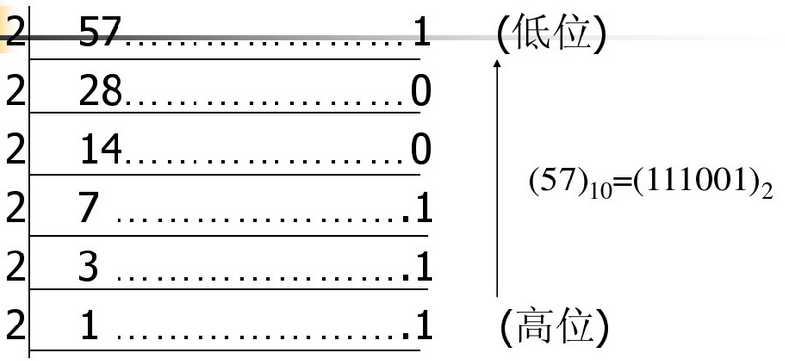
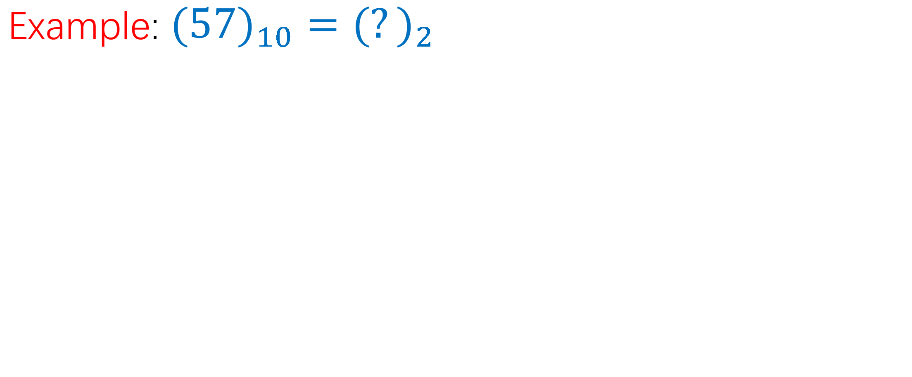
Converting decimal integer into binary integer
Example: ${(57)}_{10}={(?)}_{2}$
Lower position
Higher position

Slide 33
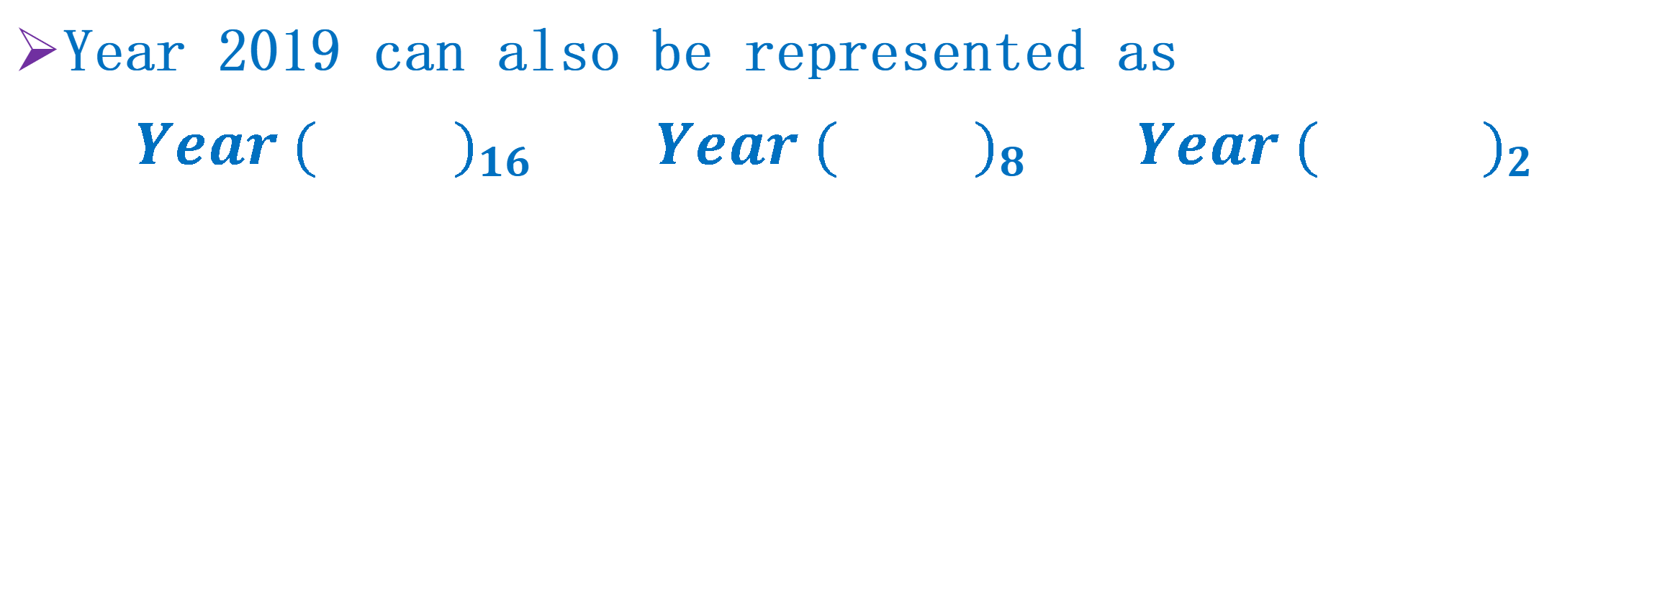
Practice 2
Year 2019 can also be represented as
$Year {( )}_{16} Year {( )}_{8} Year {( )}_{2}$

Slide 34
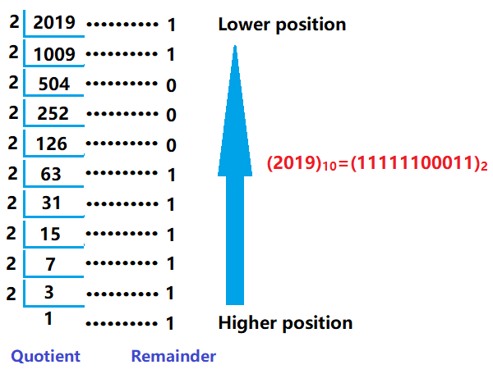
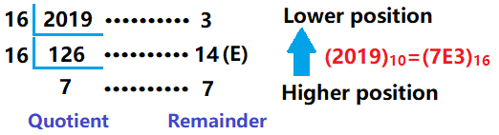
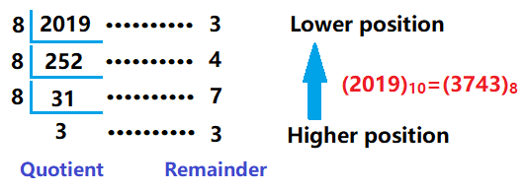
Solution

Slide 35
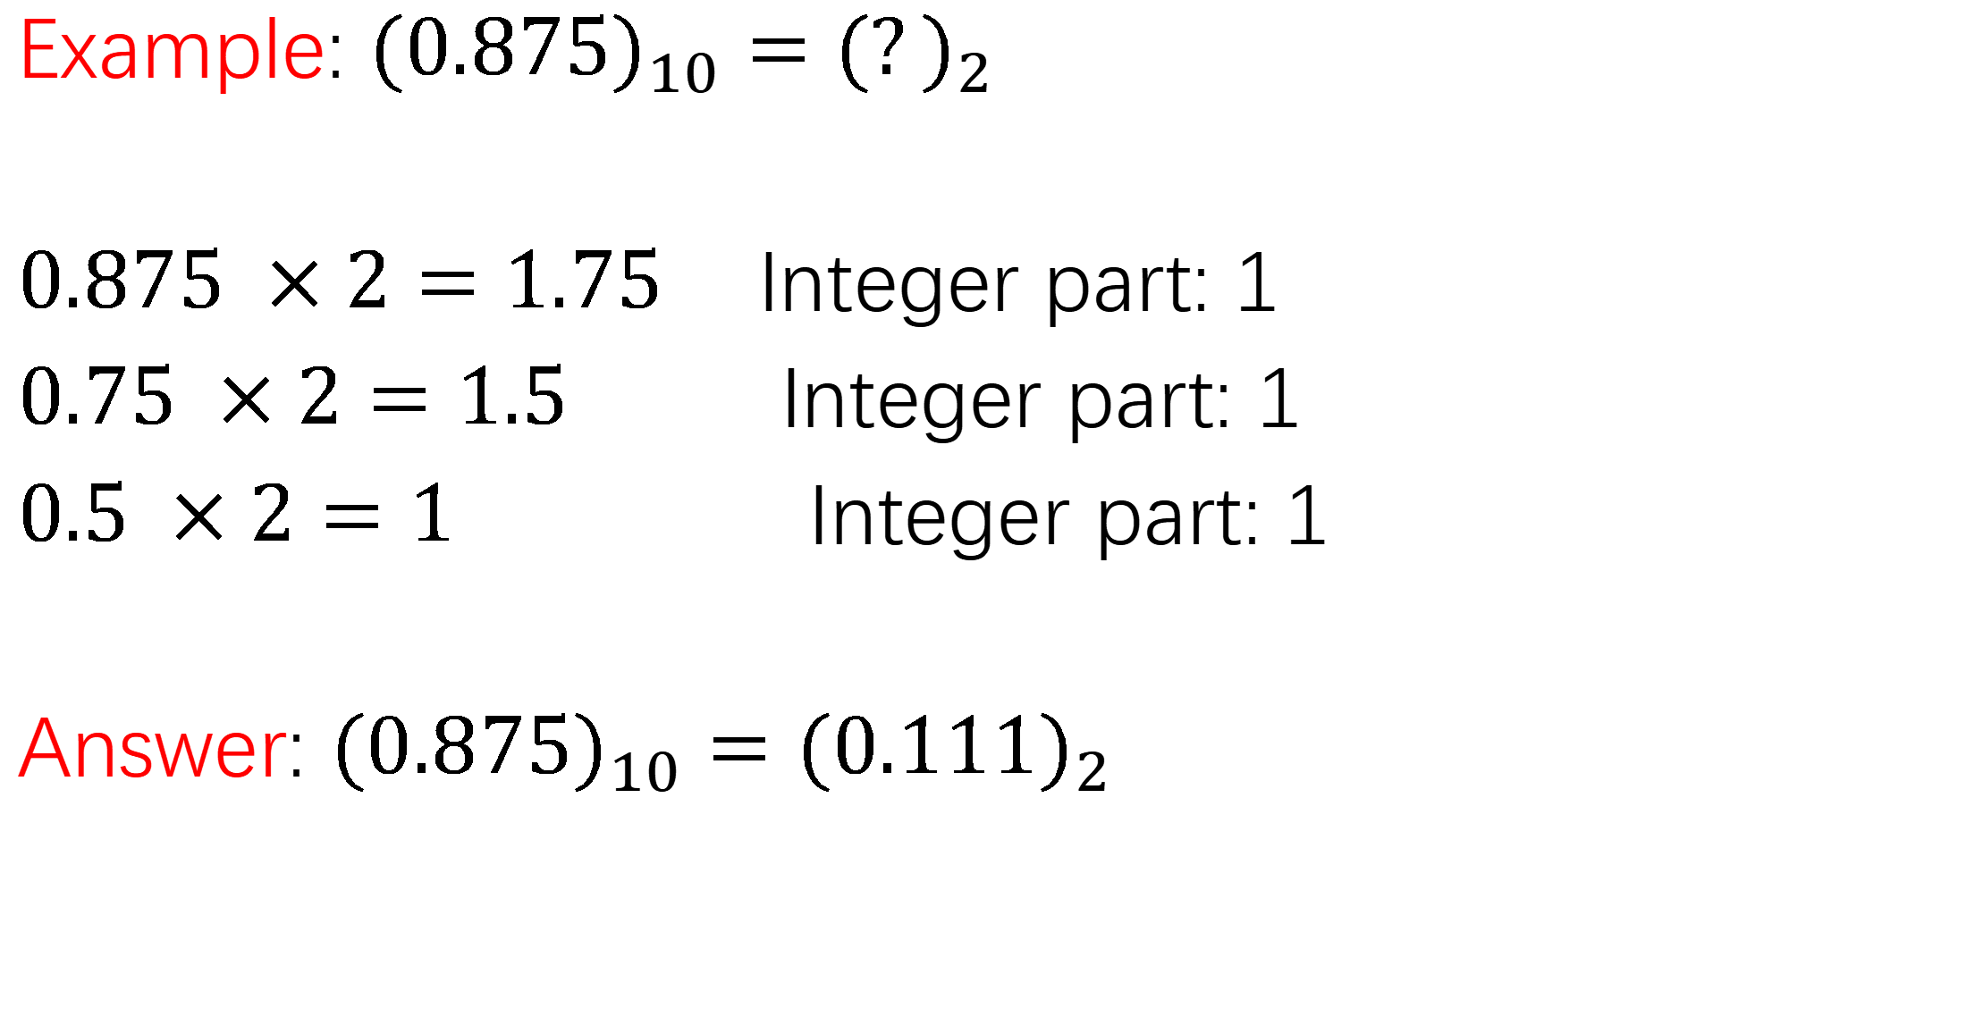
Converting decimal fraction into binary fraction
Example: ${(0.875)}_{10}={(?)}_{2}$
$0.875 ×2=1.75$ Integer part: 1
$0.75 ×2=1.5$ Integer part: 1
$0.5 ×2=1$ Integer part: 1
Answer: ${(0.875)}_{10}={(0.111)}_{2}$
Higher position
Lower position

Slide 36
Practice 3
Convert decimal number 100.96875 into binary, octal and hexadecimal number.

Slide 37
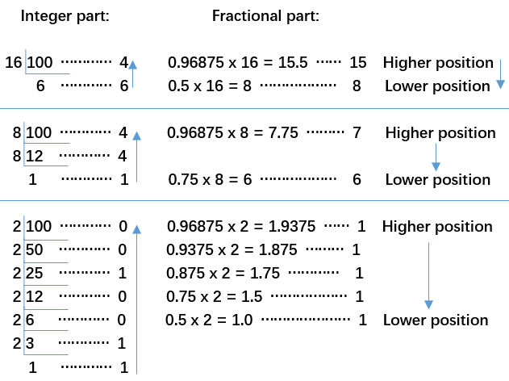
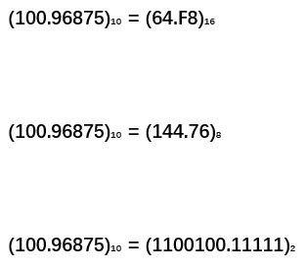
Solution

Slide 38
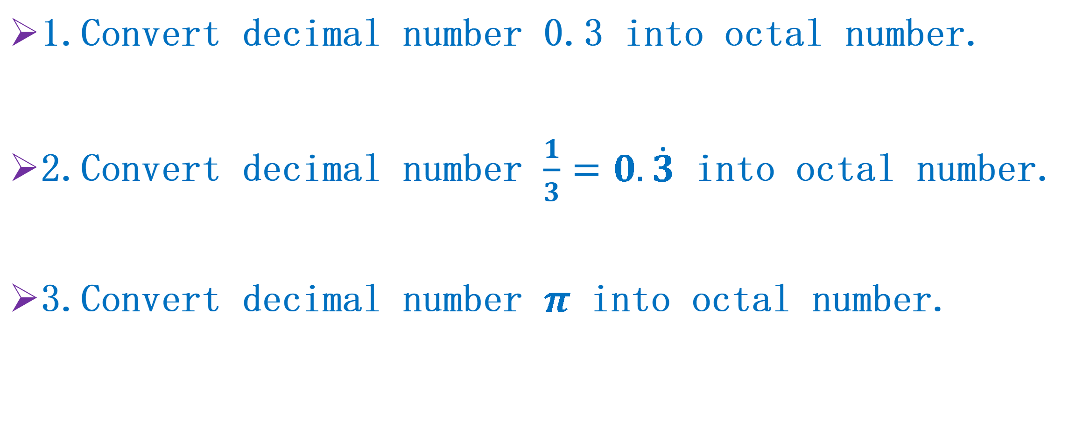
Think!
1.Convert decimal number 0.3 into octal number.
2.Convert decimal number $\frac{1}{3}=0.\dot{3}$ into octal number.
3.Convert decimal number $π$ into octal number.

Slide 39
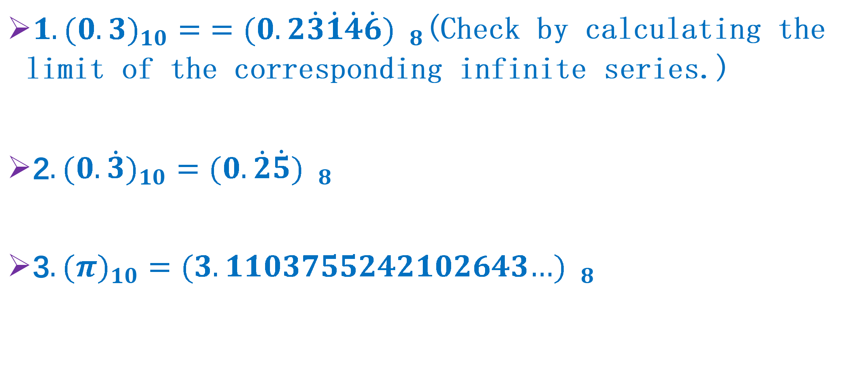
Solution?
$1.{(0.3)}_{10}={=(0.2\dot{3}\dot{1}\dot{4}\dot{6}) }_{8}$(Check by calculating the limit of the corresponding infinite series.)
2$.{(0.\dot{3})}_{10}={(0.\dot{2}\dot{5}) }_{8}$
3$.{(π)}_{10}={(3.1103755242102643…) }_{8}$

Slide 40
Conversion Between Binary, Octal and Hexadecimal
Use one-to-one relationship between
i) 3-digit binary number and the symbols of octal number;
ii) 4-digit binary number and the symbols of hexadecimal number.
Easy to do conversion between octal and hexadecimal, use binary as a bridge.
Octal
Binary
Hexadecimal

Slide 41
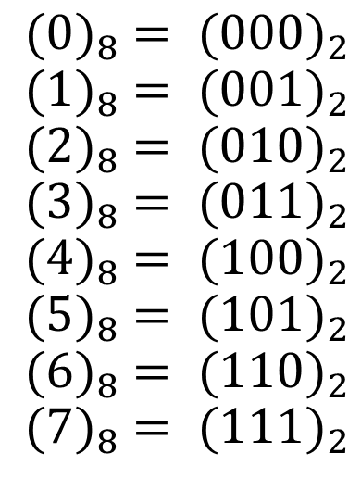
Binary and Octal
The one-to-one relationship between 3-digit binary number and the symbols of octal number.

Slide 42
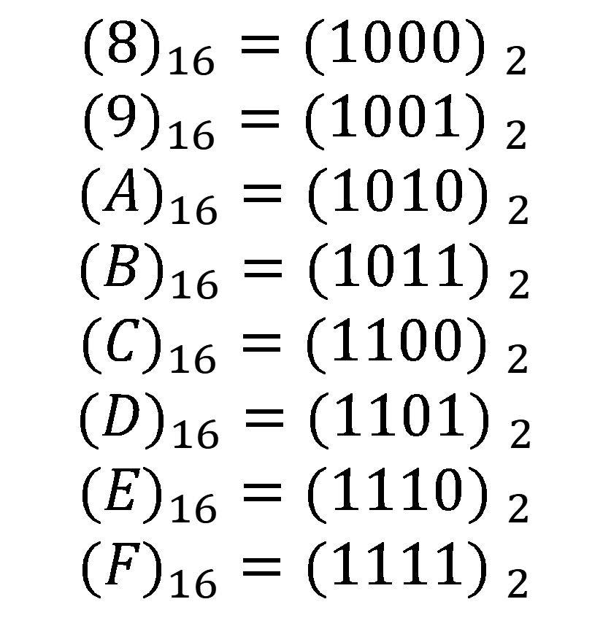
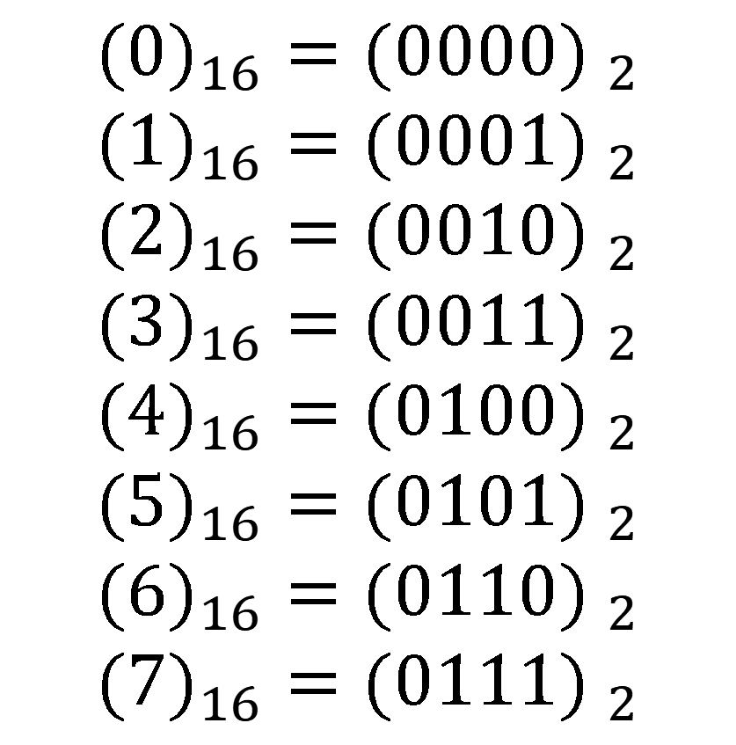
Binary and Hexadecimal
The one-to-one relationship between 4-digit binary number and the symbols of hexadecimal number.
$${(0)}_{16}={(0000) }_{2}$$
$${(1)}_{16}={(0001) }_{2}$$
$${(2)}_{16}={(0010) }_{2}$$
$${(3)}_{16}={(0011) }_{2}$$
$${(4)}_{16}={(0100) }_{2}$$
$${(5)}_{16}={(0101) }_{2}$$
$${(6)}_{16}={(0110) }_{2}$$
$${(7)}_{16}={(0111) }_{2}$$
$${(8)}_{16}={(1000) }_{2}$$
$${(9)}_{16}={(1001) }_{2}$$
$${(A)}_{16}={(1010) }_{2}$$
$${(B)}_{16}={(1011) }_{2}$$
$${(C)}_{16}={(1100) }_{2}$$
$${(D)}_{16}={(1101) }_{2}$$
$${(E)}_{16}={(1110) }_{2}$$
$${(F)}_{16}={(1111) }_{2}$$

Slide 43
Practice 4
1.Convert binary number 10100101.01011 to octal and hexadecimal number respectively.
2.Convert octal number 7654.123 to hexadecimal number.

Slide 44
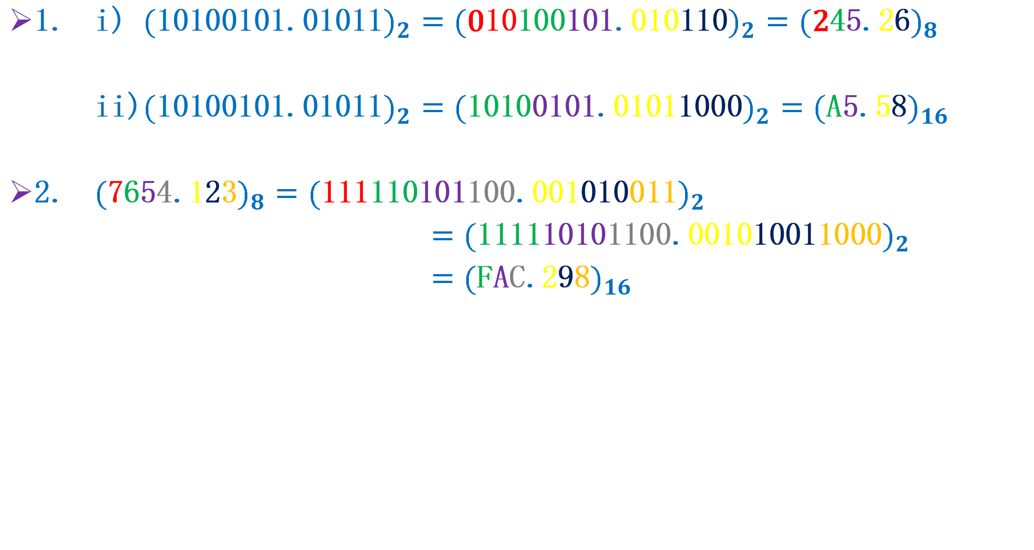
Solution
1. i) ${(\text{10100101}\text{.}\text{01011})}_{2}={(\text{0}\text{10}\text{100}\text{101}\text{.}\text{010}\text{11}\text{0})}_{2}={(\text{2}\text{4}\text{5}\text{.}\text{2}\text{6})}_{8}$
ii)${(\text{10100101}\text{.}\text{01011})}_{2}={(\text{10}\text{10}\text{0}\text{101}\text{.}\text{0101}\text{10}\text{00})}_{2}={(\text{A}\text{5}\text{.}\text{5}\text{8})}_{16}$
2. ${(\text{7}\text{6}\text{5}\text{4}\text{.}\text{1}\text{2}\text{3})}_{8}={(\text{111}\text{110}\text{101}\text{100}\text{.}\text{001}\text{010}\text{011})}_{2}$
${=(\text{111}\text{1}\text{10}\text{10}\text{1}\text{100}\text{.}\text{001}\text{0}\text{10}\text{01}\text{1000})}_{2}$
${=(\text{F}\text{A}\text{C}\text{.}\text{2}\text{9}\text{8})}_{16}$
Binary as the bridge

Slide 45
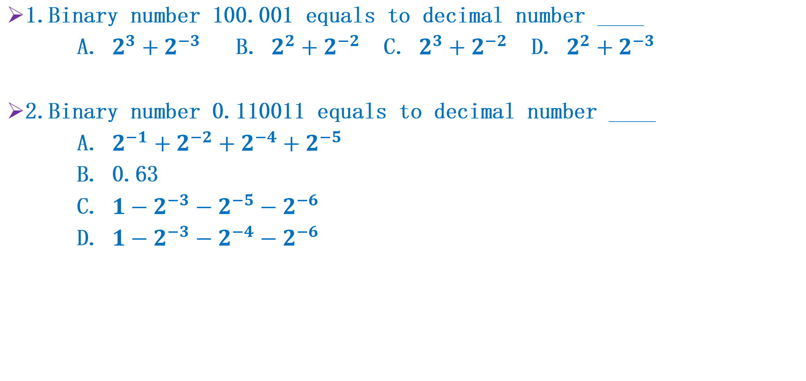
Practice 5
1.Binary number 100.001 equals to decimal number ____
A. $2^{3}+2^{−3}$ B. $2^{2}+2^{−2}$ C. $2^{3}+2^{−2}$ D. $2^{2}+2^{−3}$
2.Binary number 0.110011 equals to decimal number ____
A. $2^{−1}+2^{−2}+2^{−4}+2^{−5}$
B. 0.63
C. $1−2^{−3}−2^{−5}−2^{−6}$
D. $1−2^{−3}−2^{−4}−2^{−6}$

Slide 46
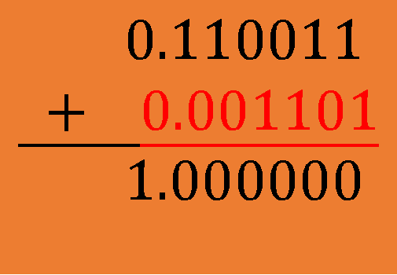
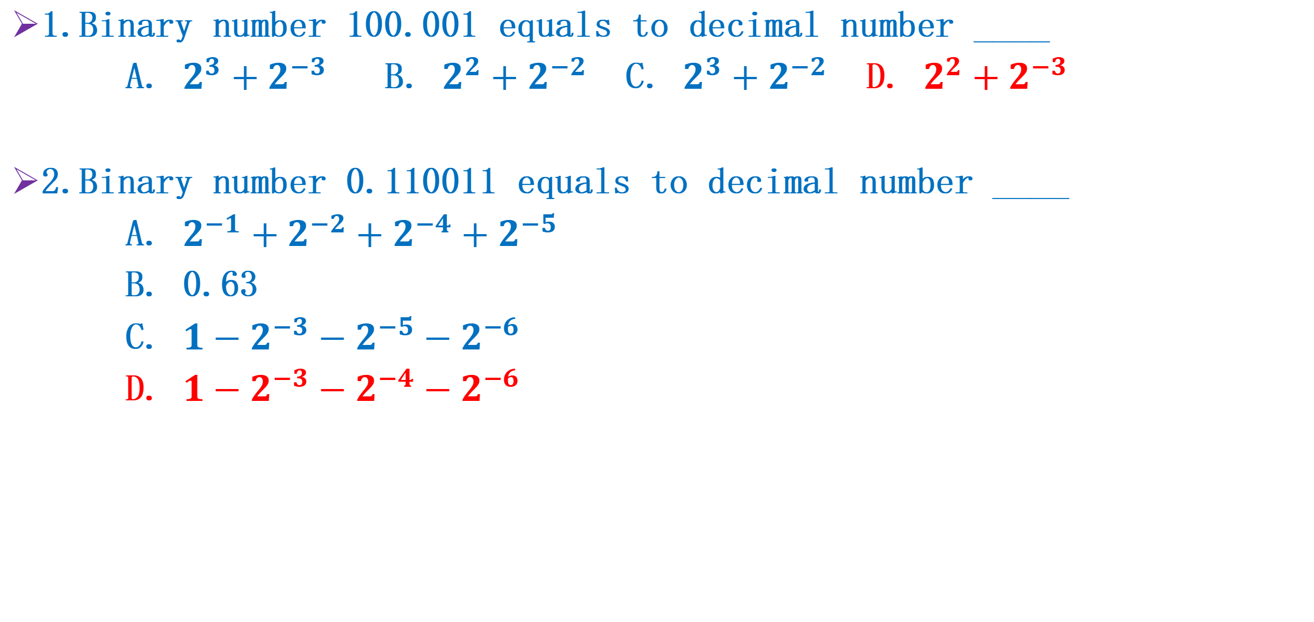
Solution
1.Binary number 100.001 equals to decimal number ____
A. $2^{3}+2^{−3}$ B. $2^{2}+2^{−2}$ C. $2^{3}+2^{−2}$ D. $2^{2}+2^{−3}$
2.Binary number 0.110011 equals to decimal number ____
A. $2^{−1}+2^{−2}+2^{−4}+2^{−5}$
B. 0.63
C. $1−2^{−3}−2^{−5}−2^{−6}$
D. $1−2^{−3}−2^{−4}−2^{−6}$
$$0.110011$$
$$+ 0.001101$$
$$1.000000$$

Slide 47
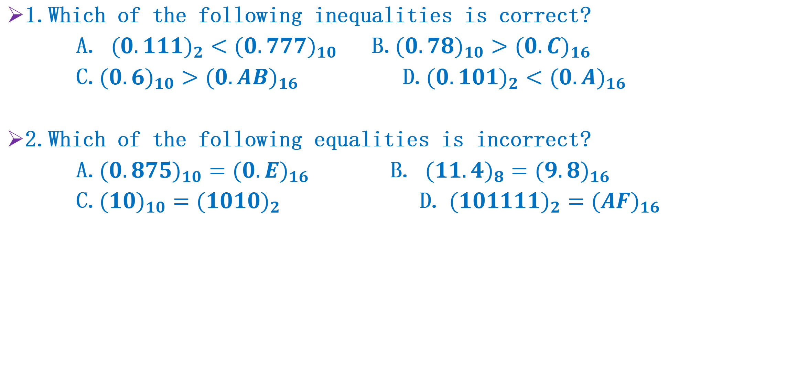
Practice 6
1.Which of the following inequalities is correct?
A. ${(0.111)}_{2}<{(0.777)}_{10}$ B.${(0.78)}_{10}>{(0.C)}_{16}$
C.${(0.6)}_{10}>{(0.AB)}_{16}$ D.${(0.101)}_{2}<{(0.A)}_{16}$
2.Which of the following equalities is incorrect?
A.${(0.875)}_{10}={(0.E)}_{16}$ B. ${(11.4)}_{8}={(9.8)}_{16}$
C.${(10)}_{10}={(1010)}_{2}$ D. ${(101111)}_{2}={(AF)}_{16}$

Slide 48
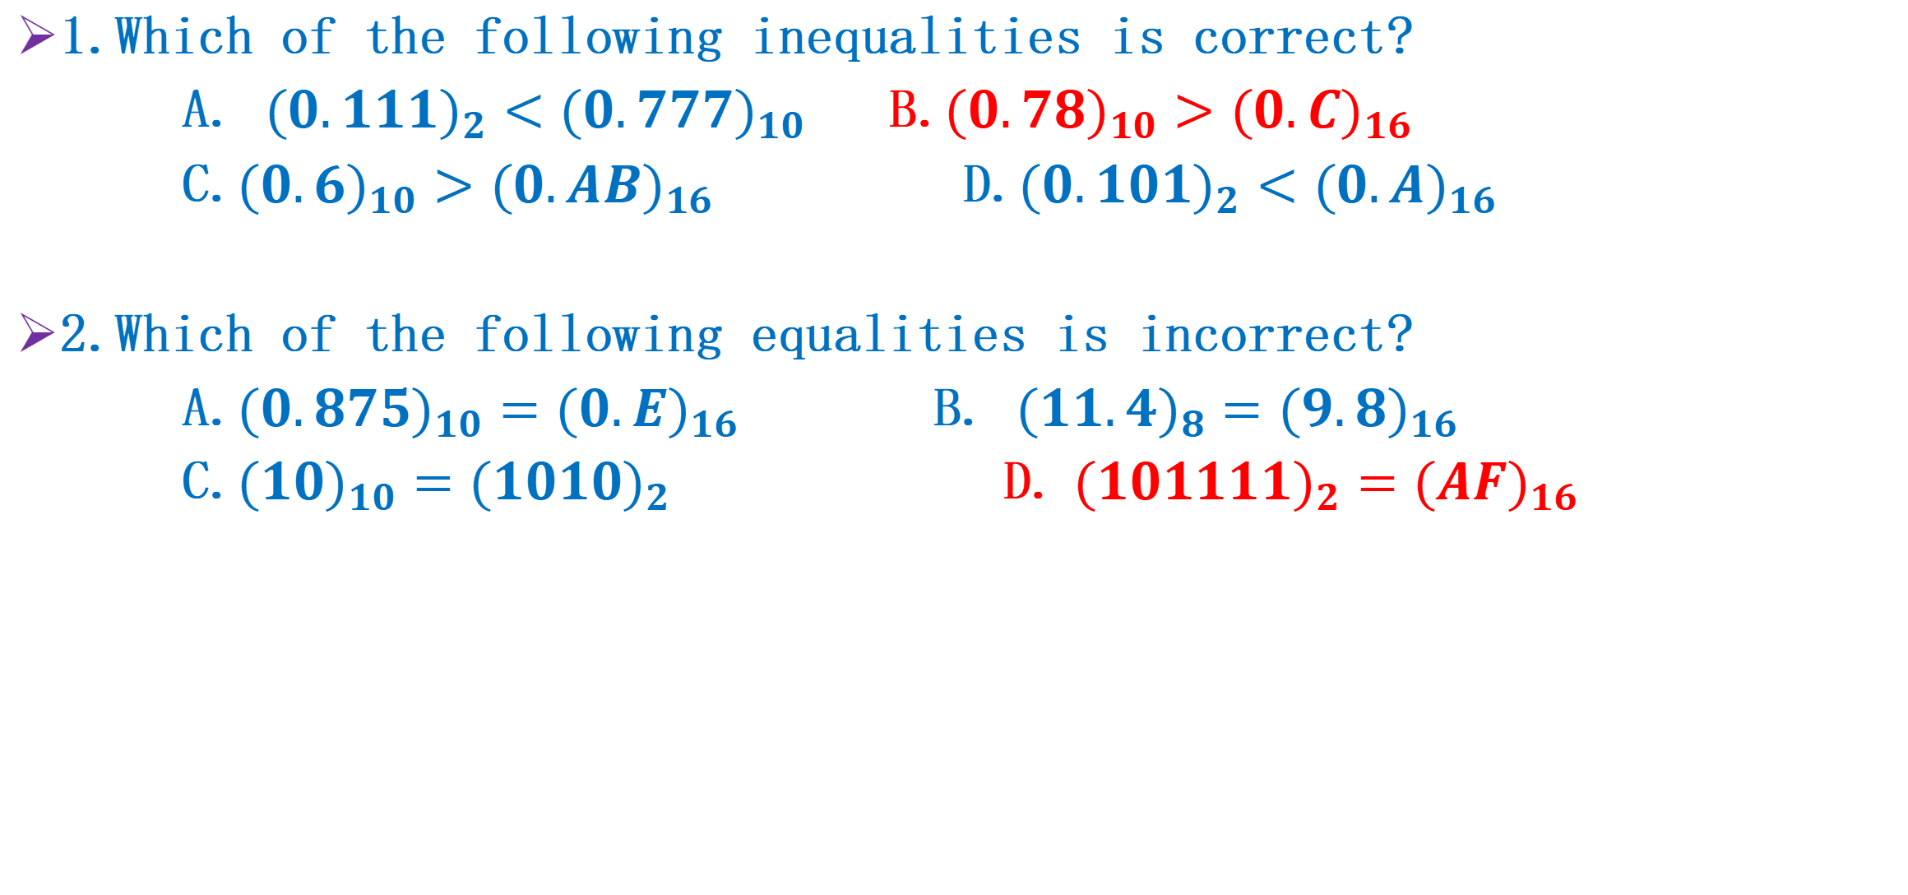
Solution
1.Which of the following inequalities is correct?
A. ${(0.111)}_{2}<{(0.777)}_{10}$ B.${(0.78)}_{10}>{(0.C)}_{16}$
C.${(0.6)}_{10}>{(0.AB)}_{16}$ D.${(0.101)}_{2}<{(0.A)}_{16}$
2.Which of the following equalities is incorrect?
A.${(0.875)}_{10}={(0.E)}_{16}$ B. ${(11.4)}_{8}={(9.8)}_{16}$
C.${(10)}_{10}={(1010)}_{2}$ D. ${(101111)}_{2}={(AF)}_{16}$

